Slide 1
Spring Framework

Slide 2
Spring Overview
Spring is an open source layered Java/J2EE application framework
Created by Rod Johnson
  Based on book “Expert one-on-one J2EE Design and Development” (October, 2002)
  Current version 2.0.6 (released on 2007-06-18)
The Spring Framework is licensed under the terms of the Apache License, Version 2.0 and can be downloaded at:
  http://www.springframework.org/download
Philosophy: J2EE should be easier to use, “Lightweight Container” concept
A software framework is a re-usable design for a software system.

Slide 3
What are Lightweight Frameworks?
Non-intrusive
No container requirements
Simplify application development
  Remove re-occurring pattern code
  Productivity friendly
  Unit test friendly
Very pluggable
Usually open source
Examples:
  Spring, Pico, Hivemind
  Hibernate, IBatis, Castor
  WebWork
  Quartz
  Sitemesh

Slide 4
Spring Mission Statement
J2EE should be easier to use
It's best to program to interfaces, rather than classes. Spring reduces the complexity cost of using interfaces to zero.
JavaBeans offer a great way of configuring applications
OO design is more important than any implementation technology, such as J2EE
Checked exceptions are overused in Java. A framework shouldn't force you to catch exceptions you're unlikely to be able to recover from.
Testability is essential, and a framework such as Spring should help make your code easier to test
Spring should be a pleasure to use
Your application code should not depend on Spring APIs
Spring should not compete with good existing solutions, but should foster integration. (For example, JDO and Hibernate are great O/R mapping solutions. Don't need to develop another one).

Slide 5
Modules of the Spring Framework
The Spring Framework can be considered as a collection of frameworks-in-the-framework:
Core - Inversion of Control (IoC) and Dependency Injection
AOP - Aspect-oriented programming
DAO - Data Access Object support, transaction management, JDBC-abstraction
ORM - Object Relational Mapping data access, integration layers for JPA, JDO, Hibernate, and iBatis
MVC - Model-View-Controller implementation for web-applications
Remote Access, Authentication and Authorization, Remote Management, Messaging Framework, Web Services, Email, Testing, …

Slide 6
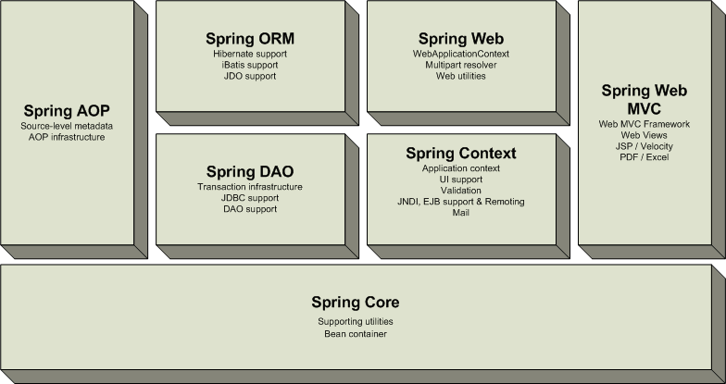
Overview of the Spring Framework
Very loosely coupled, components widely reusable and separately packaged.

Slide 7
Spring Details
Spring allows to decouple software layers by injecting a component’s dependencies at runtime rather than having them declared at compile time via importing and instantiating classes.
Spring provides integration for J2EE services such as EJB, JDBC, JNDI, JMS, JTA. It also integrates several popular ORM toolkits such as Hibernate and JDO and assorted other services as well.
One of the highly touted features is declarative transactions, which allows the developer to write transaction-unaware code and configure transactions in Spring config files.
Spring is built on the principle of unchecked exception handling. This also reduces code dependencies between layers. Spring provides a granular exception hierarchy for data access operations and maps JDBC, EJB, and ORM exceptions to Spring exceptions so that applications can get better information about the error condition.
With highly decoupled software layers and programming to interfaces, each layer is easier to test. Mock objects is a testing pattern that is very useful in this regard.

Slide 8
Advantages of Spring Architecture
Enable you to write powerful, scalable applications using POJOs
Lifecycle – responsible for managing all your application components, particularly those in the middle tier container sees components through well-defined lifecycle: init(), destroy()
Dependencies - Spring handles injecting dependent components without a component knowing where they came from (IoC)
Configuration information - Spring provides one consistent way of configuring everything, separate configuration from application logic, varying configuration
In J2EE (e.g. EJB) it is easy to become dependent on container and deployment environment, proliferation of pointless classes (locators/delegates); Spring eliminates them
Cross-cutting behavior (resource management is cross-cutting concern, easy to copy-and-paste everywhere)
Portable (can use server-side in web/ejb app, client-side in swing app, business logic is completely portable)

Slide 9
Spring Solutions
Solutions address major J2EE problem areas:
  Web application development (MVC)
  Enterprise Java Beans (EJB, JNDI)
  Database access (JDBC, iBatis, ORM)
  Transaction management (JTA, Hibernate, JDBC)
  Remote access (Web Services, RMI)
Each solution builds on the core architecture
Solutions foster integration, they do not re-invent the wheel

Slide 10
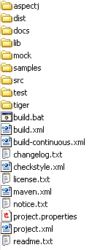
How to Start Using Spring
Download Spring from www.springframework.org, e.g.
spring-framework-2.0.6-with-dependencies.zip
Unzip to some location, e.g.
C:\tools\spring-framework-2.0.6
Folder C:\tools\spring-framework-2.0.6\dist
contains Spring distribution jar files
Add libraries to your application classpath
and start programming with Spring

Slide 11
Inversion of Control (IoC)
Central in the Spring is its Inversion of Control container
Based on “Inversion of Control Containers and the Dependency Injection pattern” (Martin Fowler)
Provides centralized, automated configuration, managing and wiring of application Java objects
Container responsibilities:
  creating objects,
  configuring objects,
  calling initialization methods
  passing objects to registered callback objects
  etc
All together form the object lifecycle which is one of the most important features
Java objects that are managed by the Spring IoC container are referred to as beans

Slide 12
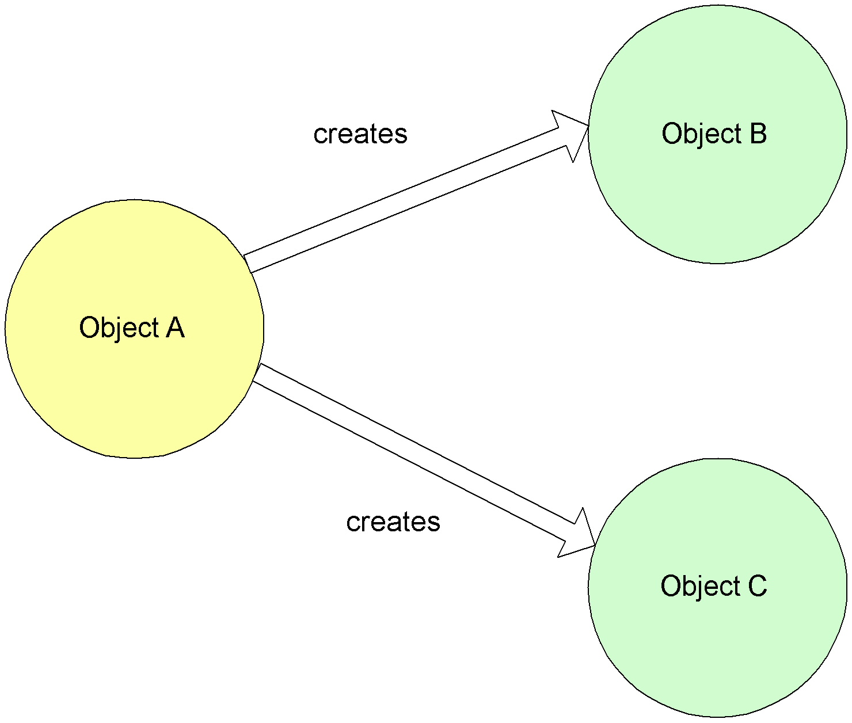
Dependency Injection – Non-IoC
public class MainBookmarkProcessor implements BookmarkProcessor{
private PageDownloader pageDownloader;
private RssParser rssParser;
public List<Bookmark> loadBookmarks()
{
// direct initialization
pageDownloader = new ApachePageDownloader();
rssParser = new JenaRssParser();
// or factory initialization
// pageDownloader = PageDownloaderFactory.getPageDownloader();
// rssParser = RssParserFactory.getRssParser();
// use initialized objects
pageDownloader.downloadPage(url);
rssParser.extractBookmarks(fileName, resourceName);
// ...
}

Slide 13
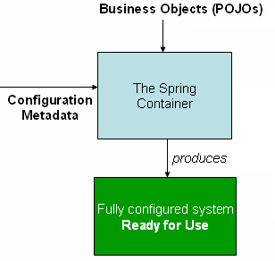
Dependency Injection - IoC
Beans define their dependencies through constructor arguments or properties
Container resolves (injects) dependencies of components by setting implementation object during runtime
BeanFactory interface - the core that
loads bean definitions and manages beans
Most commonly used implementation
is the XmlBeanFactory class
Allows to express the objects that compose
application, and the interdependencies
between such objects, in terms of XML
The XmlBeanFactory takes this XML
configuration metadata and uses it to create a fully configured system

Slide 14
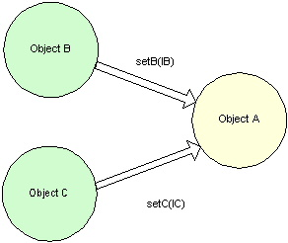
Non-IoC versus IoC
Non Inversion of Control approach
Inversion of Control approach

Slide 15
IoC Basics
Basic JavaBean pattern:
  include a “getter” and “setter” method for each field:
Rather than locating needed resources, application components provide setters through which resources are passed in during initialization
In Spring Framework, this pattern is used extensively, and initialization is usually done through configuration file rather than application code
class MyBean {
private int counter;
public int getCounter()
{ return counter; }
public void setCounter(int counter)
{ this.counter = counter; }
}

Slide 16
IoC Java Bean
public class MainBookmarkProcessor implements BookmarkProcessor{
private PageDownloader pageDownloader;
private RssParser rssParser;
public List<Bookmark> loadBookmarks()
{
pageDownloader.downloadPage(url);
rssParser.extractBookmarks(fileName, resourceName);
// ...
}
public void setPageDownloader(PageDownloader pageDownloader){
this.pageDownloader = pageDownloader;
}
public void setRssParser(RssParser rssParser){
this.rssParser = rssParser;
}

Slide 17
Configuration metadata
Spring configuration XML consists of at least one bean definition that the container must manage, but typically there will be more than one bean definition
<?xml version="1.0" encoding="UTF-8"?>
<beans xmlns="http://www.springframework.org/schema/beans"
xmlns:xsi="http://www.w3.org/2001/XMLSchema-instance" xsi:schemaLocation="http://www.springframework.org/schema/beans http://www.springframework.org/schema/beans/spring-beans-2.0.xsd">
<bean id="rssParser"
class="com.web.robot.impl.JenaRssParser"/>
<bean id="pageDownloader" class="com.web.robot.impl.ApachePageDownloader"/>
<bean id="bookmarkProcessor" class="com.web.robot.impl.MainBookmarkProcessor">
<property name="pageDownloader" ref="pageDownloader"/>
<property name="rssParser" ref="rssParser"/>
</bean>
</beans>

Slide 18
Instantiating a Container
Instantiating a Spring IoC container is easy.
Place config XML in classpath and from your code call:
Resource resource = new FileSystemResource("beans.xml");
BeanFactory factory = new XmlBeanFactory(resource);
OR
ClassPathResource resource = new ClassPathResource("beans.xml");
BeanFactory factory = new XmlBeanFactory(resource);
OR
ApplicationContext context =
new ClassPathXmlApplicationContext("applicationContext.xml");
The ApplicationContext interface builds on top of the
BeanFactory (it is a sub-interface) and adds other functionality

Slide 19
Using the Container
The BeanFactory interface has only six methods for client code to call:
  boolean containsBean(String): returns true if the BeanFactory contains a bean definition or bean instance that matches the given name.
  Object getBean(String): returns an instance of the bean registered under the given name.
  Object getBean(String, Class): returns a bean, registered under the given name. The bean returned will be cast to the given Class.
  Class getType(String name): returns the Class of the bean with the given name.
  boolean isSingleton(String): determines if the bean under the given name is a singleton.
  String[] getAliases(String): Return the aliases for the given bean name, if any were defined in the bean definition.

Slide 20
Spring Bean Definition
The bean class is the actual implementation of the bean being described by the BeanFactory
Bean examples – DAO, DataSource, Transaction Manager, Persistence Managers, Service objects, etc
Spring config contains implementation classes while your code should program to interfaces
Bean behaviors include:
  Singleton or prototype
  Autowiring
  Initialization and destruction methods
    init-method
    destroy-method
Beans can be configured to have property values set
  Can read simple values, collections, maps, references to other beans, etc

Slide 21
Spring Bean Definition
Each bean definition consists of the following set of properties:
  class
  name
  scope
  constructor arguments
  properties
  autowiring mode
  dependency checking mode
  lazy-initialization mode
  initialization method
  destruction method
Beans are created using
the instructions defined
in the configuration
metadata that has been
supplied to the container

Slide 22
Scope
The Spring Framework supports exactly five scopes:
Scope | Description
singleton | Scopes a single bean definition to a single object instance per Spring IoC container.
prototype | Scopes a single bean definition to any number of object instances.
request | Scopes a single bean definition to the lifecycle of a single HTTP request; that is each and every HTTP request will have its own instance of a bean created off the back of a single bean definition.
session | Scopes a single bean definition to the lifecycle of a HTTP Session. Only valid in the context of a web-aware ApplicationContext.
global session | Scopes a single bean definition to the lifecycle of a global HTTP Session. Typically only valid when used in a portlet context.

Slide 23
Setter/Constructor Injection
Dependency Injection exists in two major variants:
<bean id="exampleBean" class="examples.ExampleBean">
<!-- setter injection using the nested <ref/> element -->
<property name="beanOne"><ref bean="anotherExampleBean"/></property>
<!-- setter injection using the neater 'ref' attribute -->
<property name="beanTwo" ref="yetAnotherBean"/>
<property name="integerProperty" value="1"/>
</bean>
<bean id="anotherExampleBean" class="examples.AnotherBean"/>
<bean id="yetAnotherBean" class="examples.YetAnotherBean"/>
Setter
injection:
<bean id="exampleBean" class="examples.ExampleBean">
<!-- constructor injection using the nested <ref/> element -->
<constructor-arg><ref bean="anotherExampleBean"/></constructor-arg>
<!-- constructor injection using the neater 'ref' attribute -->
<constructor-arg ref="yetAnotherBean"/>
<constructor-arg type="int" value="1"/>
</bean>
<bean id="anotherExampleBean" class="examples.AnotherBean"/>
<bean id="yetAnotherBean" class="examples.YetAnotherBean"/>
Constructor
injection:

Slide 24
Autowiring Mode
It is possible to automatically let Spring resolve collaborators (other beans) for your bean by inspecting the contents of the BeanFactory.
Mode | Explanation
no | No autowiring at all.
byName | Autowiring by property name. Will inspect the container and look for a bean named exactly the same as the property which needs to be autowired.
byType | Allows a property to be autowired if there is exactly one bean of the property type in the container.
constructor | This is analogous to byType, but applies to constructor arguments.
autodetect | Chooses constructor or byType through introspection of the bean class.

Slide 25
Dependency Checking Mode
This feature is sometimes useful when you want to ensure that all properties are set on a bean.
Mode | Explanation
none | No dependency checking. Properties of the bean which have no value specified for them are simply not set.
simple | Dependency checking is performed for primitive types and collections (everything except collaborators).
object | Dependency checking is performed for collaborators only.
all | Dependency checking is done for collaborators, primitive types and collections.

Slide 26
Lazy-Initialization Mode
The default behavior for ApplicationContext implementations is to eagerly pre-instantiate all singleton beans at startup
If you do not want such a behavior, you can selectively control this by marking a bean definition as lazy-initialized
It is also possible to control lazy-initialization at the container level by using the 'default-lazy-init' attribute on the <beans/> element:
If lazy bean is the dependency of a not lazy singleton bean – don't be confused if the IoC container creates it!
<bean id="lazy" class="com.foo.ExpensiveToCreateBean" lazy-init="true"/>
<bean name="not.lazy" class="com.foo.AnotherBean"/>
<beans default-lazy-init="true">
<!-- no beans will be pre-instantiated... -->
</beans>

Slide 27
Init/Destroy Methods
Two ways to implement initialization/destruction callbacks:
  implementing InitializingBean interface
  using the 'init-method' attribute
<bean id="exampleInitBean" class="examples.AnotherExampleBean"/>
public class AnotherExampleBean implements InitializingBean {
public void afterPropertiesSet() {
// do some initialization work
}
}
<bean id="exampleInitBean" class="examples.ExampleBean" init-method="init"/>
public class ExampleBean {
public void init() {
// do some initialization work
}
}

Slide 28
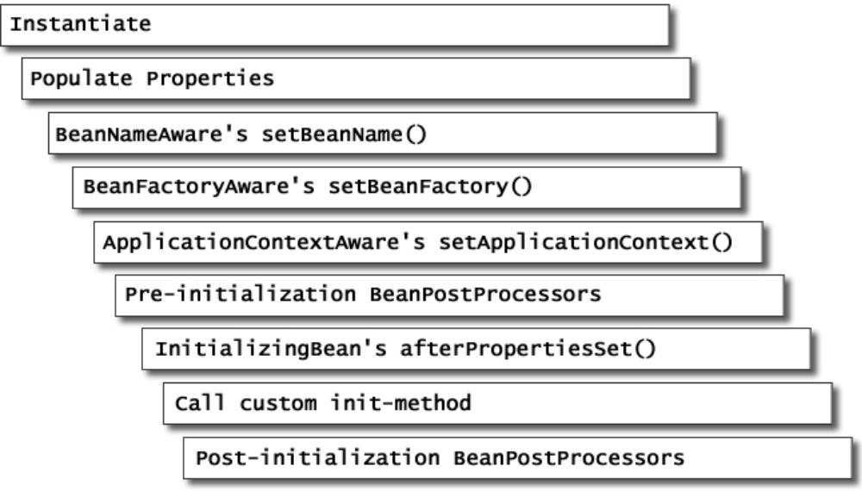
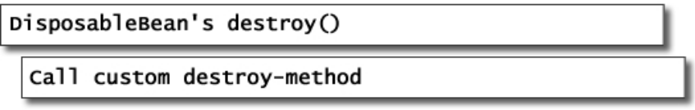
Bean Lifecycle
Beans managed by Spring have a distinct and predictable lifecycle
Spring provides
simple ways of
receiving callbacks
from lifecycle events
Hooks are purely
optional, no
dependency on Spring in your
beans – unless you want to

Slide 29
References
Spring Home:
http://www.springframework.org
Inversion of Control Containers and the Dependency Injection pattern http://www.martinfowler.com/articles/injection.html
Spring IoC Container:
http://static.springframework.org/spring/docs/2.0.x/reference/beans.html
Introduction to the Spring Framework by Rod Johnson
http://www.theserverside.com/tt/articles/article.tss?l=SpringFramework

